Slide 1
Definition of the Microprocessor
Microprocessor: It is a semiconductor device consisting of electronic logic circuits. It includes the ALU, register arrays and control circuits on a single chip.
The microprocessor has a set of instructions, designed internally, to manipulate data and communicate with peripherals.
The microprocessor is a programmable device that takes in numbers, performs on them arithmetic or logical operations according to the program stored in memory and then produces other numbers as a result.

Slide 2
Microprocessor
It only understands binary numbers.
A binary digit is called a bit (which comes from binary digit).
The microprocessor recognizes and processes a group of bits together. This group of bits is called a “word”.
A group of 8-bits were referred to as a “half-word” or “byte”.
A group of 4 bits is called a “nibble”.
Also, 32 bit groups were given the name “long word”.
Today, all processors manipulate at least 32 bits at a time and there exists microprocessors that can process 64, 80, 128 bits

Slide 3
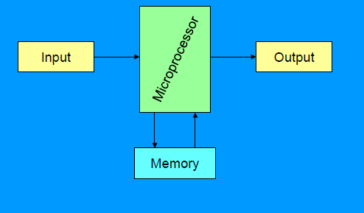
A Microprocessor-based system

Slide 4
Microprocessor
Inside The Microprocessor
Internally, the microprocessor is made up of 3 main units. The Arithmetic/Logic Unit (ALU)
The Control Unit.
An array of registers for holding data while it is being manipulated.

Slide 5
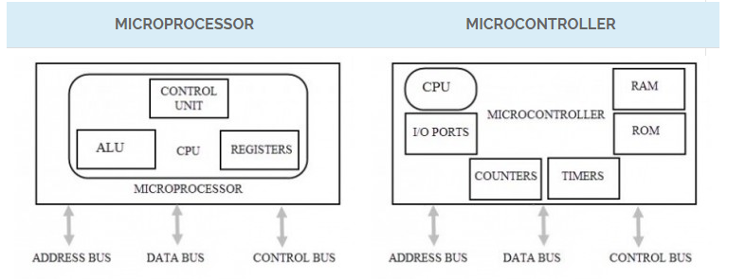
the differences between microprocessors and microcontrollers.

Slide 6
the differences between microprocessors and microcontrollers.
Microprocessor | Microcontroller
Microprocessor assimilates the function of a central processing unit (CPU) on to a single integrated circuit (IC). | Microcontroller can be considered as a small computer which has a processor and some other components in order to make it a computer.
Microprocessors are basic components of personal computers. | Microcontrollers are generally used in embedded systems
A microprocessor based system can perform numerous tasks. | A microcontroller based system can perform single or very few tasks.
In order to build or design a system (computer), a microprocessor has to be connected externally to some other components like Memory (RAM and ROM) and Input / Output ports. | The IC of a microcontroller has memory (both RAM and ROM) integrated on it along with some other components like I / O devices and timers.

Slide 7
Intel 8086 MICROPROCESSOR

Slide 8
Features
It is a 16-bit μp.
8086 has a 20 bit address bus can access up to 2²⁰ memory locations (1 MB).
It can support up to 64K I/O ports.
It provides 16 -bit registers.
Word size is 16 bits.
It has multiplexed address and data bus AD0- AD15 and A16 – A19.

Slide 9
It can prefetches up to 6 instruction bytes from memory and queues them in order to speed up instruction execution.
It requires +5V power supply.
A 40 pin dual in line package.
Address ranges from 00000H to FFFFFH
Memory is byte addressable - Every byte has a separate address.

Slide 10
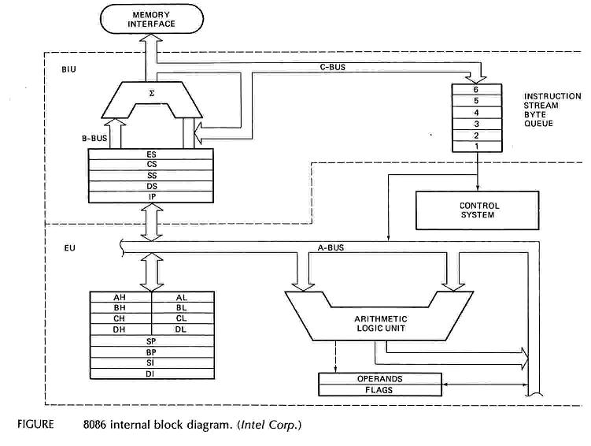
Intel 8086 Internal Architecture

Slide 11
Internal architecture of 8086
8086 has two blocks BIU and EU.
The BIU handles all transactions of data and addresses on the buses for EU.
The BIU performs all bus operations such as instruction fetching, reading and writing operands for memory and calculating the addresses of the memory operands. The instruction bytes are transferred to the instruction queue.
EU executes instructions from the instruction byte queue.

Slide 12
Both units operate asynchronously to give the 8086 an overlapping instruction fetch and execution mechanism which is called as Pipelining. This results in efficient use of the system bus and system performance.
BIU contains Instruction queue, Segment registers, Instruction pointer, Address adder.
EU contains Control circuitry, Instruction decoder, ALU, Pointer and Index register, Flag register.

Slide 13
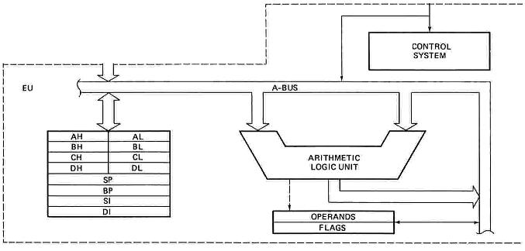
EXECUTION UNIT
Decodes instructions fetched by the BIU
Generate control signals,
Executes instructions.
The main parts are:
Control Circuitry
Instruction decoder
ALU

Slide 14
EXECUTION UNIT-Registers
16 bits
16 bits
8 bits
8 bits
8 bits
8 bits
AH | AL
BH | BL
CH | CL
DH | DL
SP
BP
SI
DI
Accumulator
AX
Accumulator
Base
BX
Base
Count
CX
Count
DX
Data
Data
Stack Pointer
Stack Pointer
Pointer
Base Pointer
Base Pointer
Source Index
Source Index
Index
Destination Index
Destination Index

Slide 15
EXECUTION UNIT – Registers
Register | Purpose
AX | Word multiply, word divide, word I /O
AL | Byte multiply, byte divide, byte I/O, decimal arithmetic
AH | Byte multiply, byte divide
BX | Store address information
CX | String operation, loops
CL | Variable shift and rotate
DX | Word multiply, word divide, indirect I/O (Used to hold I/O address during I/O instructions. If the result is more than 16-bits, the lower order 16-bits are stored in accumulator and higher order 16-bits are stored in DX register)

Slide 16
Pointer And Index Registers
used to keep offset addresses.
Used in various forms of memory addressing.
In the case of SP and BP the default reference to form a physical address is the Stack Segment (SS-will be discussed under the BIU)
The index registers (SI & DI) and the BX generally default to the Data segment register (DS).
SP: Stack pointer
– Used with SS to access the stack segment
BP: Base Pointer
– Primarily used to access data on the stack
– Can be used to access data in other segments

Slide 17
SI: Source Index register
– is required for some string operations
– When string operations are performed, the SI register points to memory locations in the data segment which is addressed by the DS register. Thus, SI is associated with the DS in string operations.
DI: Destination Index register
– is also required for some string operations.
– When string operations are performed, the DI register points to memory locations in the data segment which is addressed by the ES register. Thus, DI is associated with the ES in string operations.
The SI and the DI registers may also be used to access data stored in arrays

Slide 18
EXECUTION UNIT – Flag Register
A flag is a flip flop which indicates some conditions produced by the execution of an instruction or controls certain operations of the EU .
In 8086 The EU contains
➢ a 16 bit flag register
➢9 of the 16 are active flags and remaining 7 are undefined.
➢ 6 flags indicates some conditions- status flags
➢3 flags –control Flags
U | U | U | U | OF | DF | IF | TF | SF | ZF | U | AF | U | PF | U | CF
Sign
Auxiliary
Carry
Interrupt
Trap
Zero
Parity
Over flow
Direction
U - Unused

Slide 19
EXECUTION UNIT – Flag Register
Flag | Purpose
Carry (CF) | Holds the carry after addition or the borrow after subtraction. Also indicates some error conditions, as dictated by some programs and procedures .
Parity (PF) | PF=0;odd parity, PF=1;even parity.
Auxiliary (AF) | Holds the carry (half – carry) after addition or borrow after subtraction between bit positions 3 and 4 of the result (for example, in BCD addition or subtraction.)
Zero (ZF) | Shows the result of the arithmetic or logic operation. Z=1; result is one. Z=0; The result is 0
Sign (SF) | Holds the sign of the result after an arithmetic/logic instruction execution. S=1; negative, S=0

Slide 20
Flag | Purpose
Trap (TF) | A control flag. Enables the trapping through an on-chip debugging feature.
Interrupt (IF) | A control flag. Controls the operation of the INTR (interrupt request) I=0; INTR pin disabled. I=1; INTR pin enabled.
Direction (DF) | A control flag. It selects either the increment or decrement mode for DI and /or SI registers during the string instructions.
Overflow (OF) | Overflow occurs when signed numbers are added or subtracted. An overflow indicates the result has exceeded the capacity of the Machine

Slide 21
Execution unit – Flag Register
Six of the flags are status indicators reflecting properties of the last arithmetic or logical instruction.
For example, if register AL = 7Fh and the instruction ADD AL,1 is executed then the following happen
AL = 80h
CF = 0; there is no carry out of bit 7
PF = 0; 80h has an odd number of ones
AF = 1; there is a carry out of bit 3 into bit 4
ZF = 1; the result is not zero
SF = 1; bit seven is one
OF = 1; the sign bit has changed

Slide 22
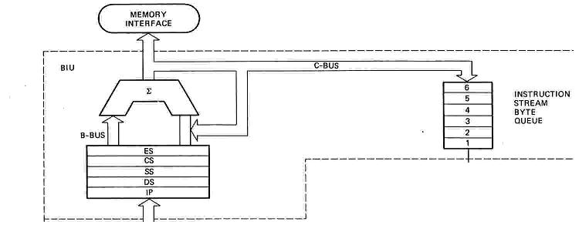
BUS INTERFACE UNIT (BIU)
Contains
6-byte Instruction Queue (Q)
The Segment Registers (CS, DS, ES, SS).
The Instruction Pointer (IP).
The Address Summing block (Σ)

Slide 23
THE QUEUE (Q)
The BIU uses a mechanism known as an instruction stream queue to implement a pipeline architecture.
This queue permits pre-fetch of up to 6 bytes of instruction code. Whenever the queue of the BIU is not full, it has room for at least two more bytes and the BIU is free to look ahead in the program by pre-fetching the next sequential instruction.
These pre-fetching instructions are held in its FIFO queue. With its 16 bit data bus, the BIU fetches two instruction bytes in a single memory cycle.
The EU accesses the queue from the output end. It reads one instruction byte after the other from the output of the queue.

Slide 24
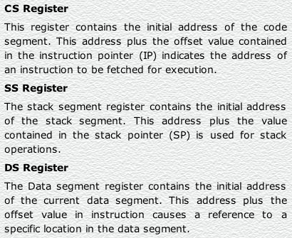
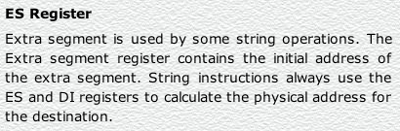

Slide 25
Instruction pointer & summing block
The instruction pointer register contains a 16-bit offset address of instruction that is to be executed next.
The IP always references the Code segment register (CS).
The value contained in the instruction pointer is called as an offset because this value must be added to the base address of the code segment, which is available in the CS register to find the 20-bit physical address.
The value of the instruction pointer is incremented after executing every instruction.
To form a 20bit address of the next instruction, the 16 bit address of the IP is added (by the address summing block) to the address contained in the CS , which has been shifted four bits to the left.

Slide 26
Introduction to 8086 Assembly Language
Assembly Language Programming

Slide 27
Program Statements
Program consist of set of statements.
Each statement is either an instruction, which the assembler translate into machine code, or assembler directive, which instructs the assembler to perform some specific task, such as allocating memory space for a variable or creating a procedure.
Both instructions and directives have up to four fields:
At least one blank or tab character must separate the fields
name operation operand(s) comment

Slide 28
Program Statements
An example of an instruction is
START: MOV CX,5 ; initialize counter
The name field consists of the label START:
The operation is MOV, the operands are CX and 5
And the comment is ; initialize counter
name operation operand(s) comment
An example of an assembler directive is
MAIN PROC
MAIN is the name, and the operation field contains PROC
This particular directive creates a procedure called MAIN
name operation operand(s) comment

Slide 29
Program Statements
name operation operand(s) comment
A Name field identifies a label, variable, or symbol.
It may contain any of the following character : A,B…..Z ; a,b….z ; 0,1….9 ; ? ;
_ (underline) ; @ ; $ ; . (period)
Only the first 31 characters are recognized
There is no distinction between uppercase and lower case letters.
The first character may not be a digit
If it is used, the period ( . ) may be used only as the first character.
A programmer-chosen name may not be the same as an assembler reserved word.

Slide 30
Program Statements
name operation operand(s) comment
Operation field is a predefined or reserved word
mnemonic - symbolic operation code.
The assembler translates a symbolic opcode into a machine language opcode.
Opcode symbols often discribe the operation’s function; for example, MOV, ADD, SUB
assembler directive - pseudo-operation code.
In the operation field if it contains an assembler directive then it is called as pseudo-operation code (pseudo-op)
Pseudo-op are not translated into machine code; for example the PROC pseudo-op is used to create a procedure

Slide 31
Program Statements
name operation operand(s) comment
An operand field specifies the data that are to be acted on by the operation.
An instruction may have zero, one, or two operands. For example:
NOP No operands; does nothing
INC AX one operand; adds 1 to the
contents of AX
ADD WORD1,2 two operands; adds 2 to the contents of memory word WORD1

Slide 32
Program Statements
name operation operand(s) comment
The comment field is used by the programmer to say something about what the statement does.
A semicolon marks the beginning of this field, and the assembler ignores anything typed after semicolon.
Comments are optional, but it is always good to include, because assembly language is low level program, it is almost impossible to understand an assembly language program without comments.

Slide 33
Program Data and Storage
Pseudo-ops to define data or reserve storage
DB - byte(s)
DW - word(s)
DD - doubleword(s)
DQ - quadword(s)
DT - tenbyte(s)
These directives require one or more operands
define memory contents
specify amount of storage to reserve for run-time data

Slide 34
Defining Data
Numeric data values
100 - decimal
100B - binary
100H - hexadecimal
'100' - ASCII
"100" - ASCII
Use the appropriate DEFINE directive (byte, word, etc.)
A list of values may be used - the following creates 4 consecutive words
DW 40H,10B,-13,0
A ? represents an uninitialized storage location
DB 255,?,-128,'X'

Slide 35
Naming Storage Locations
Names can be associated with storage locations
ANum DB -4
X DD ?
These names are called variables
ANum refers to a byte storage location, initialized to FCh
X is an unitialized doubleword

Slide 36
• Multiple definitions can be abbreviated
Example:
message DB ’B’
DB ’y’
DB ’e’
DB 0DH
DB 0AH
can be written as
message DB ’B’,’y’,’e’,0DH,0AH
• More compactly as
message DB ’Bye’,0DH,0AH

Slide 37
Arrays
Any consecutive storage locations of the same size can be called an array
X DW 40H,10B,-13,0
Y DB 'This is an array'
Z DD -109236, FFFFFFFFH, -1, 100B
Components of X are at X, X+2, X+4, X+6
Components of Y are at Y, Y+1, …, Y+15
Components of Z are at Z, Z+4, Z+8, Z+12

Slide 38
DUP
Allows a sequence of storage locations to be defined or reserved
Only used as an operand of a define directive
DB 40 DUP (?) ; 40 bytes, uninitialized
DW 10 DUP (0) ; 10 words, initialized as 0
Table1 DW 10 DUP (?) ; 10 words, uninitialized
message DB 3 DUP (’Baby’) ; 12 bytes, initialized ; as BabyBabyBaby
Name1 DB 30 DUP (’?’) ; 30 bytes, each
; initialized to ?

Slide 39
DUP
The DUP directive may also be nested
Example
stars DB 4 DUP(3 DUP (’*’),2 DUP (’?’),5 DUP (’!’))
Reserves 40-bytes space and initializes it as
***??!!!!!***??!!!!!***??!!!!!***??!!!!!
matrix DW 10 DUP (5 DUP (0))
defines a 10X5 matrix and initializes its elements to zero.
This declaration can also be done by
matrix DW 50 DUP (0)

Slide 40
Word Storage

Slide 41
Named Constants
Symbolic names associated with storage locations represent addresses
Named constants are symbols created to represent specific values determined by an expression
Named constants can be numeric or string
Some named constants can be redefined
No storage is allocated for these values

Slide 42
Equal Sign Directive
name = expression
expression must be numeric
these symbols may be redefined at any time
maxint = 7FFFh
count = 1
DW count
count = count * 2
DW count

Slide 43
EQU Directive
name EQU expression
expression can be string or numeric
Use < and > to specify a string EQU
these symbols cannot be redefined later in the program
sample EQU 7Fh
aString EQU <1.234>
message EQU <This is a message>

Slide 44
Data Transfer Instructions
MOV target, source
reg, reg
mem, reg
reg, mem
mem, immed
reg, immed
Sizes of both operands must be the same
reg can be any non-segment register except IP cannot be the target register
MOV's between a segment register and memory or a 16-bit register are possible

Slide 45
Sample MOV Instructions
b db 4Fh
w dw 2048
mov bl,dh
mov ax,w
mov ch,b
mov al,255
mov w,-100
mov b,0
When a variable is created with a define directive, it is assigned a default size attribute (byte, word, etc)

Slide 46
Program Segment Structure
Data Segments
Storage for variables
Variable addresses are computed as offsets from start of this segment
Code Segment
contains executable instructions
Stack Segment
used to set aside storage for the stack
Stack addresses are computed as offsets into this segment
Segment directives
.data
.code
.stack size

Slide 47
Program Skeleton
.model small
.stack 100H
.data
;declarations
.code
main proc
;code
main endp
;other procs
end main
Select a memory model
Define the stack size
Declare variables
Write code
organize into procedures
Mark the end of the source file
optionally, define the entry point

Slide 48
EXAMPLE : Adding two 8 bit numbers
DATA SEGMENT ; Data Segment
N1 DB 12H
N2 DB 21H
RES DB ?
DATA ENDS
CODE SEGMENT ; Code segment
ASSUME CS: CODE, DS: DATA
START: MOV AX, DATA
MOV DS, AX
MOV AL, N1
MOV BL, N2
ADD AL, BL
MOV RES, AL
INT 21H
CODE ENDS
END START

Slide 49
Subtracting 2 16 bit numbers
PROGRAM:
DATA SEGMENT
N1 DW 4444H
N2 DW 2121H
RES DW ?
DATA ENDS
CODE SEGMENT
ASSUME CS:CODE, DS:DATA
START: MOV AX,DATA
MOV DS,AX
MOV AX,N1
MOV BX,N2
SUB AX,BX
MOV RES,AX
INT 21H
CODE ENDS
END START

Slide 50
Arithmetic Instructions on 16 bit data Multiplication
data segment
a dw 1234h
b dw 5678h
c dw ?
d dw ?
data ends
code segment
assume ds:data, cs:code
start:
mov ax,data
mov ds,ax
mov ax,a
mov bx,b
mul bx
mov c,ax
mov d,dx
int 21H
code ends
end start

Slide 51
Arithmetic Instructions on 16 bit data Division
data segment
a dw 4444h
b dw 0002h
c dw ?
data ends
code segment
assume ds:data, cs:code
start:
mov ax,data
mov ds,ax
mov ax,a
mov bx,b
div bx
mov c,ax
int 21H
code ends
end start

Slide 52
Instruction types Data transfer instructions
8086 instruction set
IN Input byte or word from port
LAHF Load AH from flags
LDS Load pointer using data segment
LEA Load effective address
LES Load pointer using extra segment
MOV Move to/from register/memory
OUT Output byte or word to port
POP Pop word off stack
POPF Pop flags off stack
PUSH Push word onto stack
PUSHF Push flags onto stack
SAHF Store AH into flags
XCHG Exchange byte or word
XLAT Translate byte
Additional 80386 instructions
LFS Load pointer using FS
LGS Load pointer using GS
LSS Load pointer using SS
MOVSX Move with sign extended
MOVZX Move with zero extended
POPAD Pop all double (32 bit) registers
POPD Pop double register
POPFD Pop double flag register
PUSHAD Push all double registers
PUSHD Push double register
PUSHFD Push double flag register
Additional 80486 instruction
BSWAP Byte swap
Additional 80286 instructions
INS Input string from port
OUTS Output string to port
POPA Pop all registers
PUSHA Push all registers
Additional Pentium instruction
MOV Move to/from control register

Slide 53
Arithmetic instructions
8086 instruction set
AAA ASCII adjust for addition
AAD ASCII adjust for division
AAM ASCII adjust for multiply
AAS ASCII adjust for subtraction
ADC Add byte or word plus carry
ADD Add byte or word
CBW Convert byte or word
CMP Compare byte or word
CWD Convert word to double-word
DAA Decimal adjust for addition
DAS Decimal adjust for subtraction
DEC Decrement byte or word by one
DIV Divide byte or word
IDIV Integer divide byte or word
IMUL Integer multiply byte or word
INC Increment byte or word by one
MUL Multiply byte or word (unsigned)
NEG Negate byte or word
SBB Subtract byte or word and carry (borrow)
SUB Subtract byte or word
Additional 80386 instructions
CDQ Convert double-word to quad-word
CWDE Convert word to double-word
Additional 80486 instructions
CMPXCHG Compare and exchange
XADD Exchange and add
Additional Pentium instruction
CMPXCHG8B Compare and exchange 8 bytes

Slide 54
Bit manipulation instructions
8086 instruction set
AND Logical AND of byte or word
NOT Logical NOT of byte or word
OR Logical OR of byte or word
RCL Rotate left trough carry byte or word
RCR Rotate right trough carry byte or word
ROL Rotate left byte or word
ROR Rotate right byte or word
SAL Arithmetic shift left byte or word
SAR Arithmetic shift right byte or word
SHL Logical shift left byte or word
SHR Logical shift right byte or word
TEST Test byte or word
XOR Logical exclusive-OR of byte or word
Additional 80386 instructions
BSF Bit scan forward
BSR Bit scan reverse
BT Bit test
BTC Bit test and complement
BTR Bit test and reset
BTS Bit test and set
SETcc Set byte on condition
SHLD Shift left double precision
SHRD Shift right double precision

Slide 55
String instructions
8086 instruction set
CMPS Compare byte or word string
LODS Load byte or word string
MOVS Move byte or word string
MOVSB(MOVSW) Move byte string (word string)
REP Repeat
REPE (REPZ) Repeat while equal (zero)
REPNE (REPNZ) Repeat while not equal (not zero)
SCAS Scan byte or word string
STOS Store byte or word string

